Slide 1
“Collaborative Learning Blocks and How to Bust Them - a Perspective”
By
Praseed Pai

Slide 2
Collaboration Imperative
It has been found out that Collaborative Teamwork is one of the most important attribute of a successful team. But, it does not mean Collaborative Teamwork guarantee you Success.

Slide 3
THREE ANECDOTES ABOUT GREAT TEAMS IN SPORTS

Slide 4
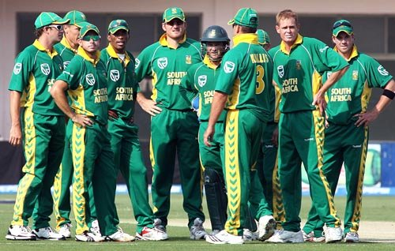
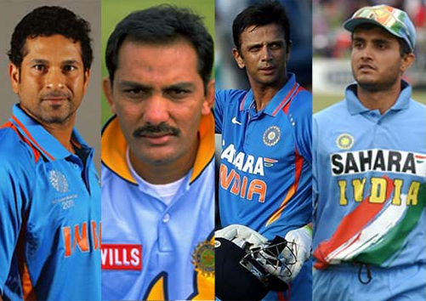
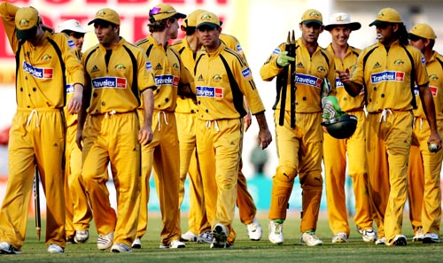
1999 World Cup teams

Slide 5
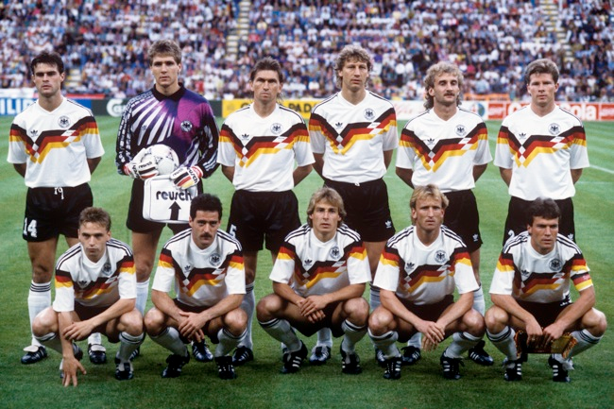
German Soccer Team
"Football is a simple game. Twenty-two men chase a ball for 90 minutes and at the end, the Germans always win." - Gary Lineker (Golden boot Winner, 1986 world cup )
http://praseedp.blogspot.in/2014/07/gary-linekar-was-right.html

Slide 6
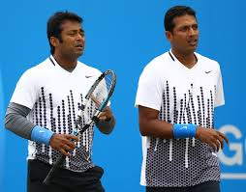
An Indian success story!

Slide 7
All that was in Sports, What about others?
Great Corporations
Community meetups
Startups
Organizing Events
SIGs ( Special Interest Groups)
Universities & Colleges

Slide 8
Learning Hindrances For the Individuals
Bottom up Learning
Individual Learning Blocks

Slide 9
Bottom up Learning
Learn Fundamentals, go to the lowest level of abstraction, iteratively learn more and more advanced topics to reach “Knowledge Bliss”
Excellent for learning things, when you do not have people around who knows what you are learning
A method apt suited for creating future “Scientists”, where as most of the people are “Craftsmen” (Artists and Engineers)
Satisfies the need for “Cognitive Closure” and a Self satisficing exercise
Was good during the pre-internet era and schools and colleges emphasize it

Slide 10
Individual Learning Blocks
Mental Blocks are there for everyone!
Framing, Fundamental Attribution Errors, Loss Aversion etc.
Religious and Cultural Bias
Aversion to certain things because of past experiences
Lack of a “Stupidity Ring”
Lack of Peer Pressure

Slide 11

Mental Blocks

Slide 12
Biases and Fallacies

Slide 13
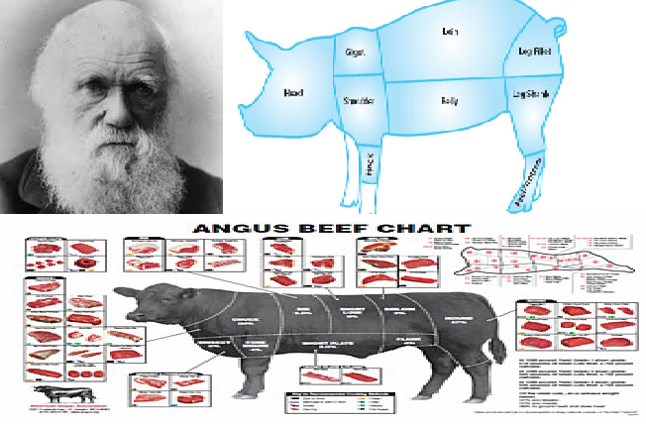
Religious and Cultural Bias

Slide 14
Haunted! - MathoPhobia

Slide 15
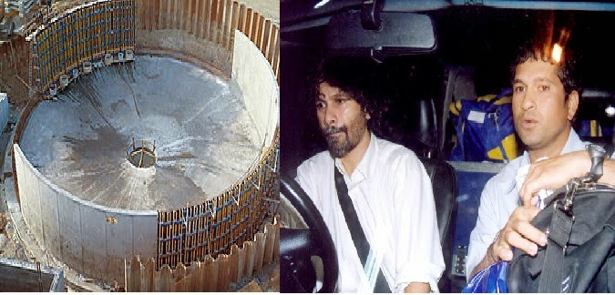
Stupidity Ring
http://praseedp.blogspot.in/2014/09/you-know-about-stupidity-ring.html

Slide 16

Peer Pressure

Slide 17
How to Overcome Individual Learning Blocks
“Top Down” Learning
Learn By Doing approach
Identify and try to bust the blocks

Slide 18
How Can an Individual stretch beyond his limit?
Join forces with like minded people to form teams
Collaborate with Others to improve the odds for success

Slide 19
“Kerala Law of Intellectual Collaboration”
http://praseedp.blogspot.in/2013/03/kerala-law-of-intellectual-collaboration.html
"A and B can collaborate in intellectual pursuits, only if there is mutual incompetence between them on their respective areas of Interest and subjects can be acquired by each other without much investment in time or effort"

Slide 20
Factors which Prevent Collaboration
Lack of Intellectual transparency
Better People Syndrome
Intellectual Caste System
Nihilism
Rank Holder Syndrome
Intra group Politics
Lack of a stated Goal

Slide 21
Better People Syndrome
http://praseedp.blogspot.in/2010/03/better-people-syndrome.html
“When Netherlands and Korea Play soccer, it is expected that Dutch will win every time. Give One extra player to the Korean team. The Korean team will win more times. ( As the differential between players at international level is small)”

Slide 22
Intellectual caste system
Harvard/Sloan/Stanford Management Graduates MIT/Stanford/Brown/Ivy league Graduates IIM IIT NITs Govt run state colleges (CET,GEC etc) Private Elite institutes Donation Colleges Polytechnics Automatic Graduates ITIs

Slide 23
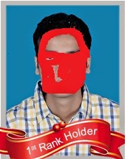
“Rank Holder” Syndrome
http://praseedp.blogspot.in/2014/10/rank-holder-syndrome-and-software.html

Slide 24
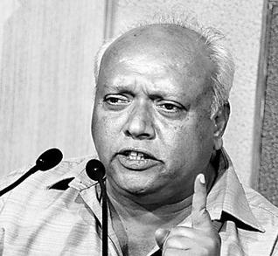
Intra-Group Politics
What is Politics?
Politics is ethics applied to a group of people.
Human Beings are inherently Political.
Politics is good!
Capital can overcome everything

Slide 25
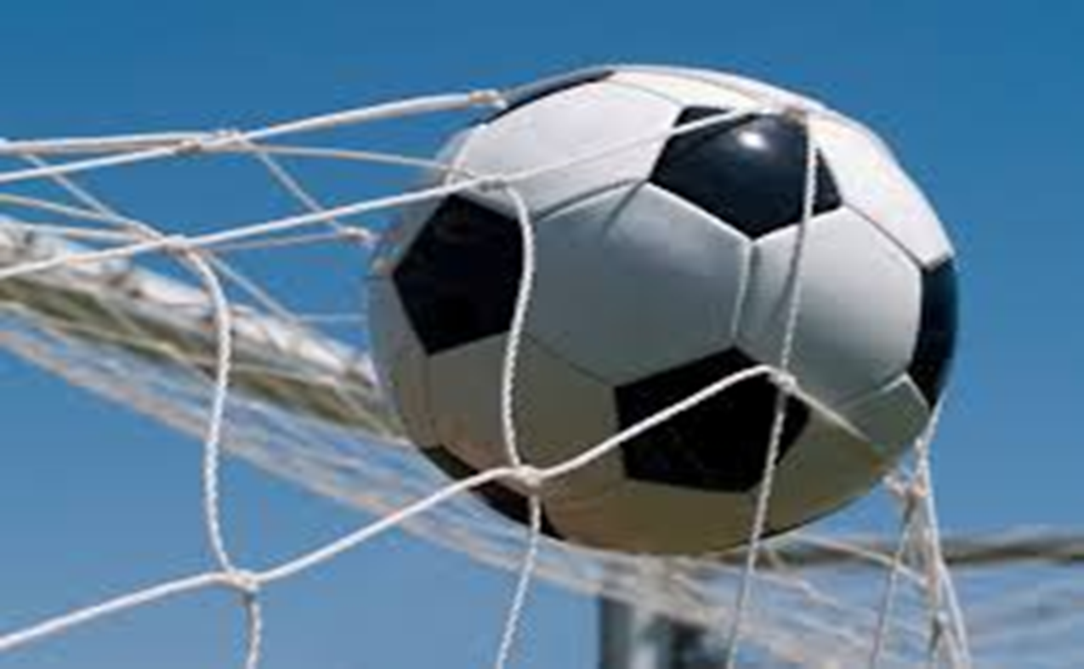
There should be a “GOAL” to stay focused!

Slide 26
Know what you are doing?
Five class of “makers”!
Thinkers
Entrepreneur mindset
Process Mindset
Craftsmen Mindset
Technicians Mindset

Slide 27

REST is

Slide 28
Thank You

